Slide 1
Centralized Logging & Data Analytics with ElasticSearch (ELK)
Yun Tse Wu
Mercedes-Benz Research and Development North America, Inc.

Slide 2
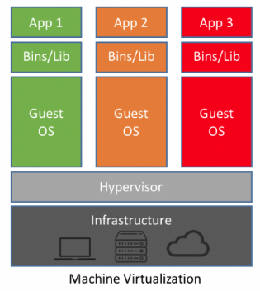
Traditional Application Stack
Cluster - LoadBalancing
Database | Application Server
Virtual Machine
Hypervisor
Machine

Slide 3
Operation
Ever increasing dataset and logs
Requires manual operation to maintain application and database server
Ineffective cost management
Metal Machines has 3-4 years cost on renewing and refreshing CPU count, increasing RAM allocation, replacing hard drives
Managing Virtual Machines is a headache, especially when it comes to patching and upgrading code

Slide 4
What industry came up with
Baking software installation steps on Virtual Machine spin up time
Cloudinit scripts
Configuration management with chef/puppet/ansible
Log management
Log streaming technologies to manage increasing sizes of data on the hard drives
Log management software with logrotate, rsyslog, consul
Custom Image
Using scripts and tools to pre-bake applications and code so that it won’t be necessary for for any more code execution for a server to be ready

Slide 5
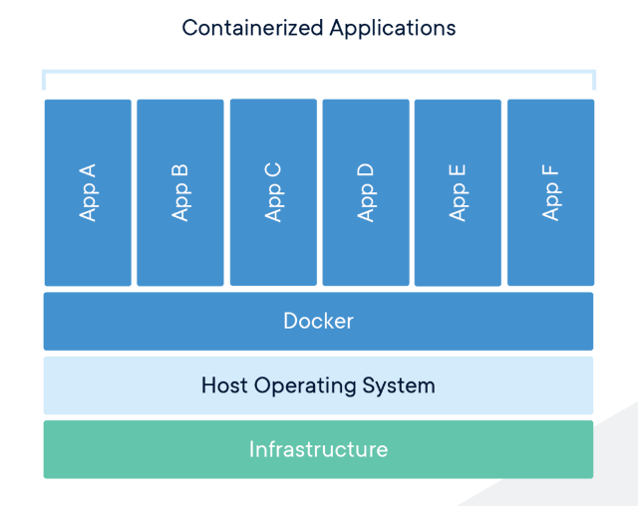
Docker container

Slide 6
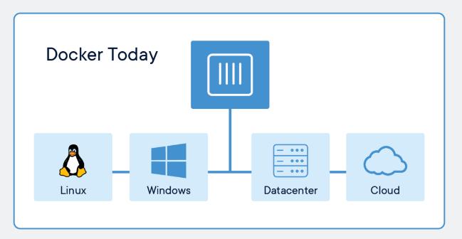
Docker container

Slide 7
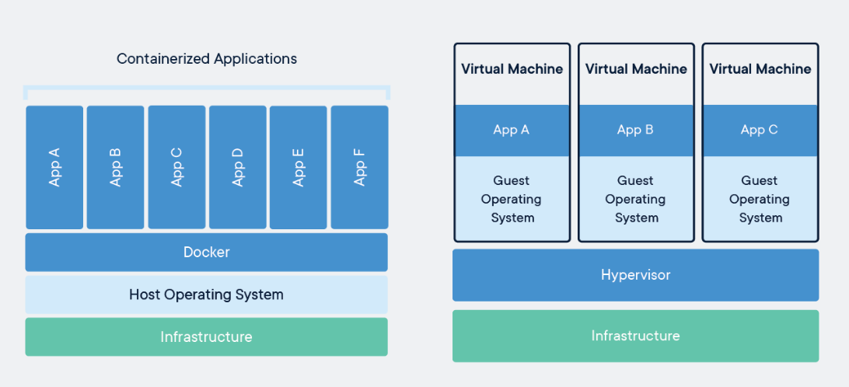
Docker container & Virtual Machines

Slide 8
Centralized logging
Centralized logs are indispensable to troubleshooting
give you access to data correlated from multiple sources across your systems
locally logged environment, you’d need to go from system to system, open multiple windows, and attempt to piece things together
Centralized logs help you proactively manage your network
proactive instead of reactive, nipping problems in the bud before they even occur
Centralized logs help you deliver greater value
Trend analysis
business intelligence
Centralized logs reduce the risk of losing data
removes the individual server from the equation
Centralized logs improve your network security

Slide 9
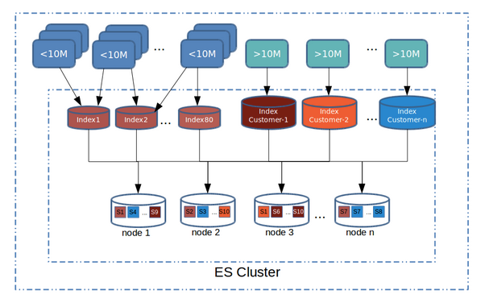
ElasticSearch
SUPER FAST data querying and analysis
Data is always indexed/cached
Scalable
Supports application, logs, numbers, geo, text...etc format

Slide 10
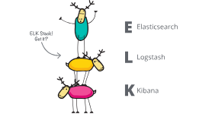
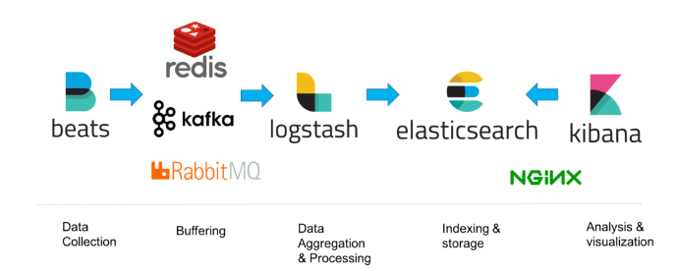
ElasticSearch - ELK Stack
Frontend - Kibana
Search/Store/Analyze - ElasticSearch
Data ingestion - Logstash, Beats

Slide 11
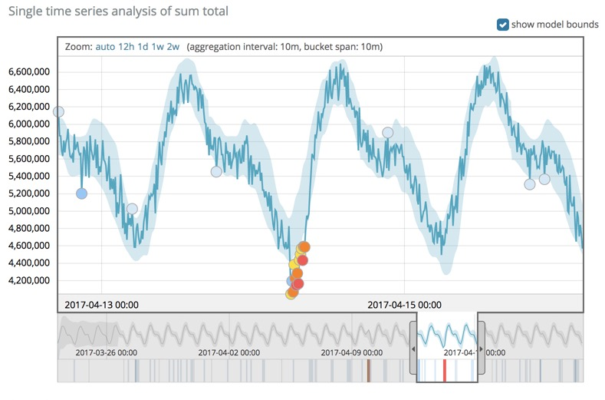
ElasticSearch - ML
Data Ingestion
Graph and Dashboard
Machine Learning (Anomaly detection)

Slide 12

Q&A
yun_tse.wu@daimler.com
windsor106@gmail.com
Twitter #windsor106

